Slide 1

Sales Report and Market Analysis for Fudge Mart Inc.
Santhosh Arunagiri, Lead BI Technology Analyst
Grace Luan, Lead Data Architect
GS Consulting, Inc
12/17/2023

Slide 2
Business Case & Goal
The business case of the project is to build a data warehouse from scratch and provide BI solutions by integrating Fudgemart and Fudgeflix data as Fudge Mart Inc. and provide recommendations on enhancing business sales and bringing insights on business and marketing opportunities.

Slide 3
Business Process
Increase overall sales for both Fudgemart and Fudgeflix.
Manage and improve the return policy process.
Manage product demand and supply.
Increase ratings of the products and titles.
Identify more business opportunities by merging the Fudgemart and Fudgeflix customer databases. How could streaming business help driving more sales, or vice versa.

Slide 4
Business Questions
What are the top 5 and bottom 5states in sales?
What are the most and the least popular products at Fudgemart?
What are the products that have generated the most and the least revenue for Fudgemart?
Which plan tier is the most and the least popular for Fudgeflix?
KPIs of company performance.
Identify more opportunities. Is adding Fudgeflix streaming services benefit the company’s overall performance?

Slide 5
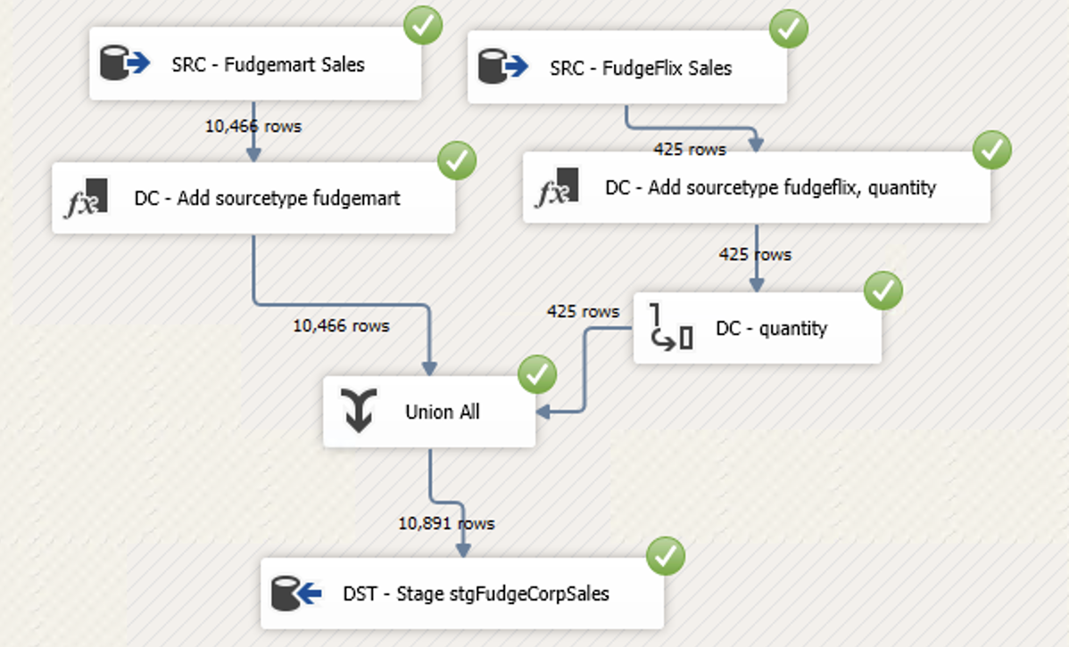
How We Achieve it?
Stage Fudgemart Customer
Combined as Fudge Customer
Load to DW
Fudge Customer
ETL Tools Used - SSIS, SSAS
BI Tools Used - Power BI & Microsoft PowerPivot
Stage Fudgeflix Customer
Stage Fudgemart Produt
Combined as Fudge Product
Load to DW
Fudge Product
Stage Fudgeflix Product
Stage Fudgemart Sales
Combined as Fudge Sales
Load to DW
Fudge Sales
Stage Fudgeflix Sales

Slide 6
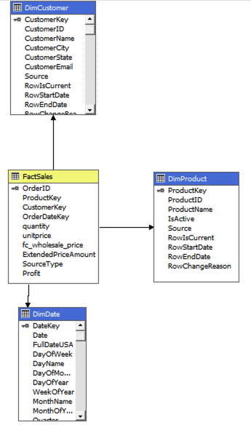
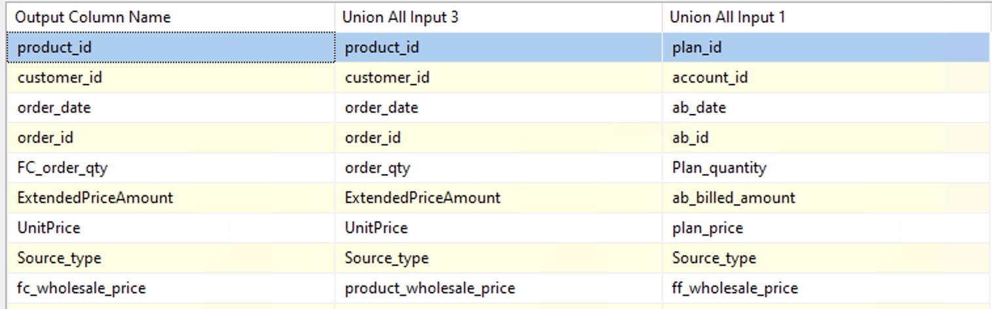
MOLAP Cube - Star Schemas
Assumptions:
Quantity for Fudgeflix: [billed amount]/[plan pirce] = 1
To get Fudgeflix’s profit, use [plan price] – 0, since we are not given the operational cost, and the company already purchased the titles.
To get Fudgemart profit, use [unit price] – [wholesale price]

Slide 7
Showcase the Interactive BI Dashboard

Slide 8
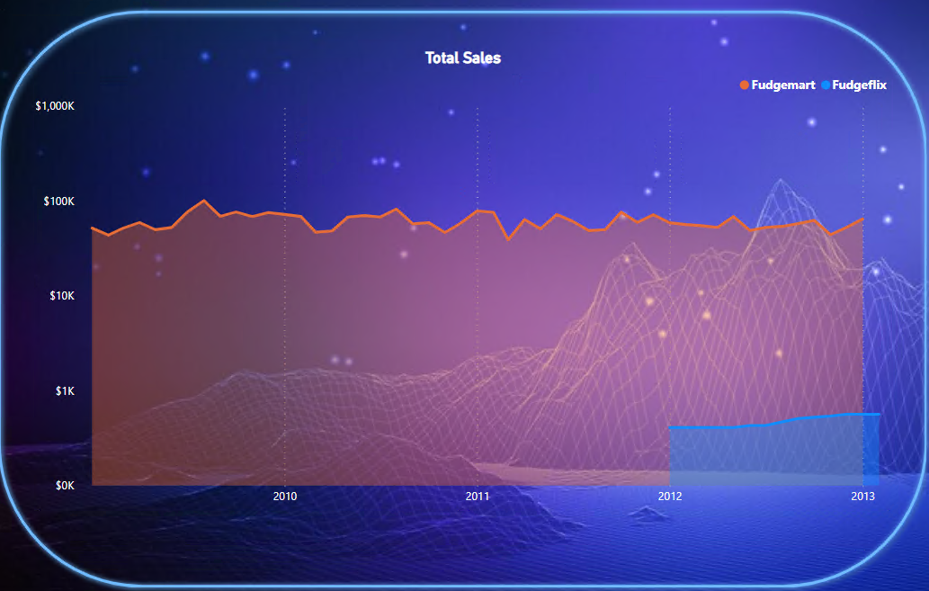
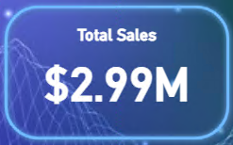
Fudge Mart Inc. Analysis
Overall sales: The combined sale of Fudgemart and Fudgeflix is approx. ~ 2.99 M

Slide 9
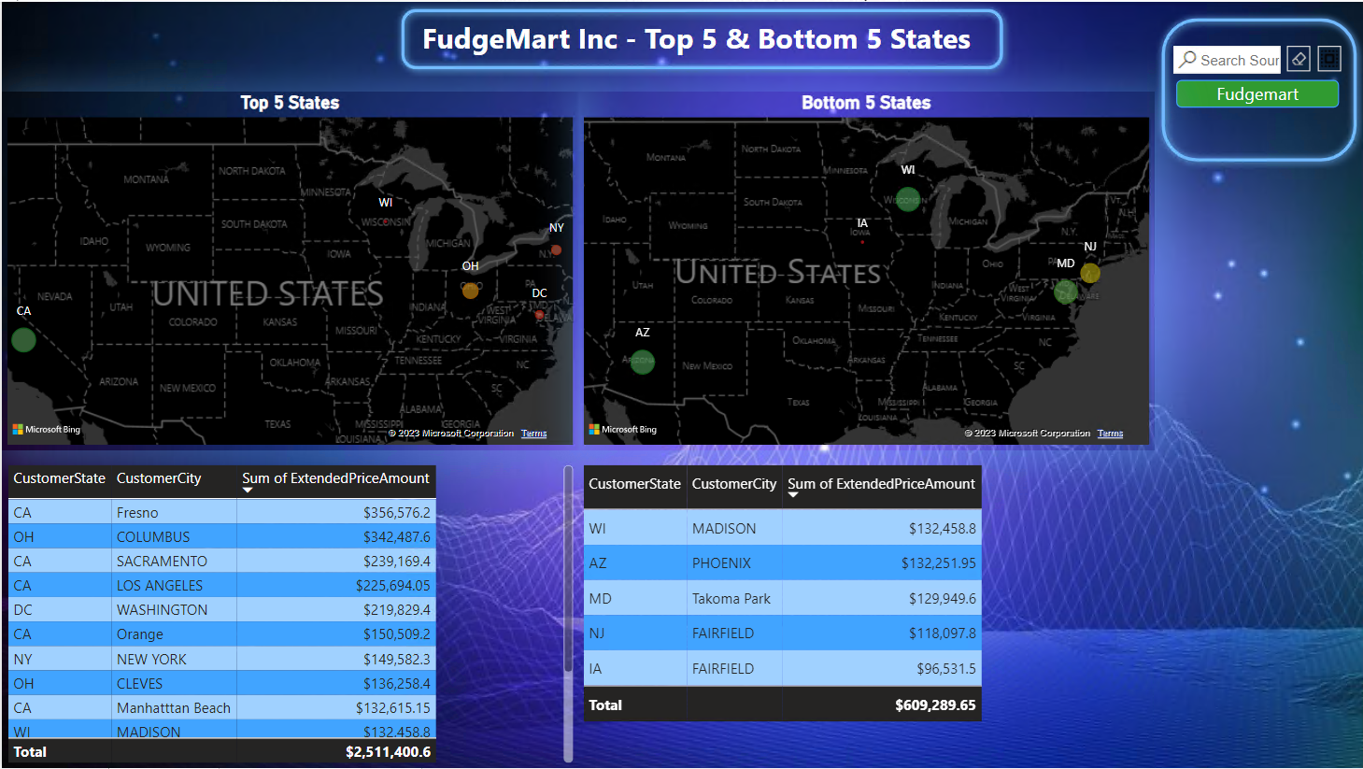
Fudge Mart Inc. Analysis
States top 5, and bottom 5

Slide 10
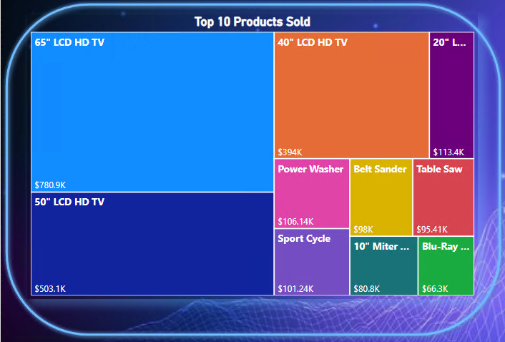
Fudge Mart Inc. Analysis
Top 10 Products Sold in Fudgemart

Slide 11
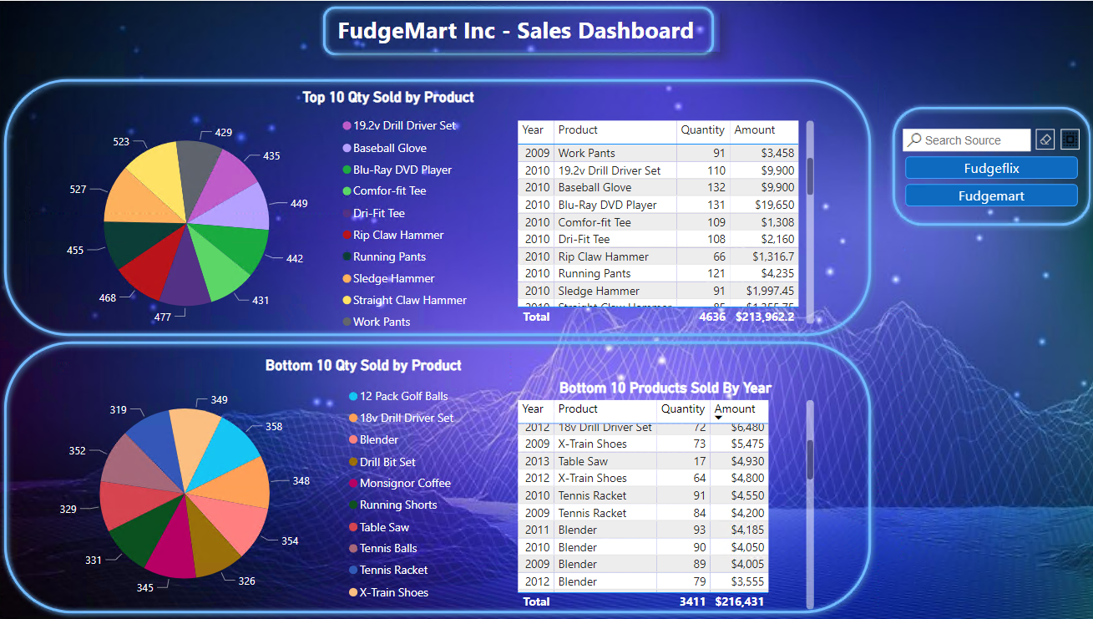
Fudge Mart Inc. Analysis
Top & Botton 10 Qty Sold by Product

Slide 12
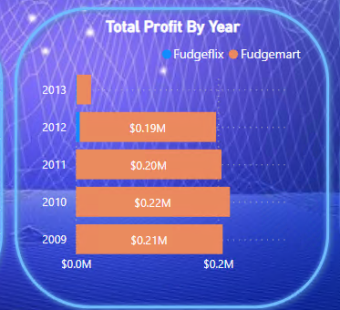
Fudge Mart Inc. Analysis

Slide 13
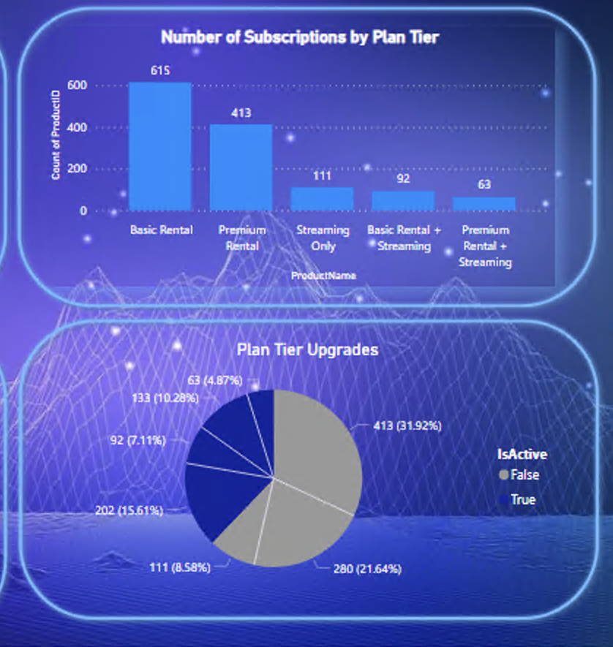
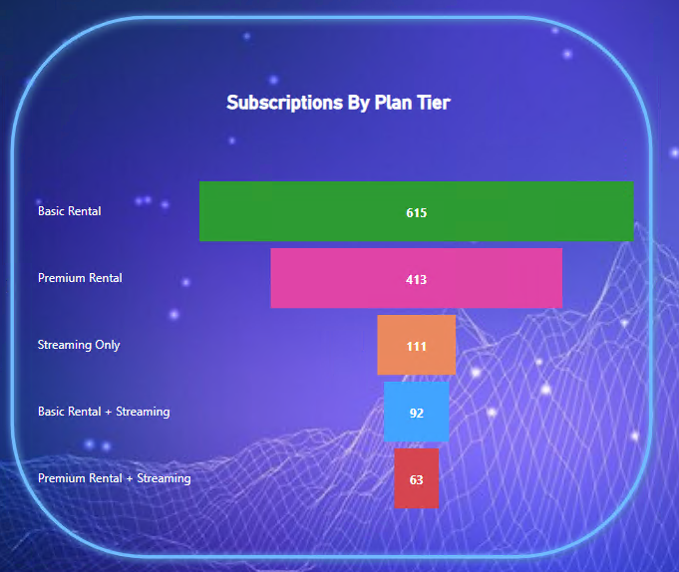
Fudge Mart Inc. Analysis

Slide 14
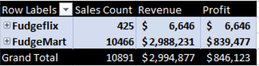
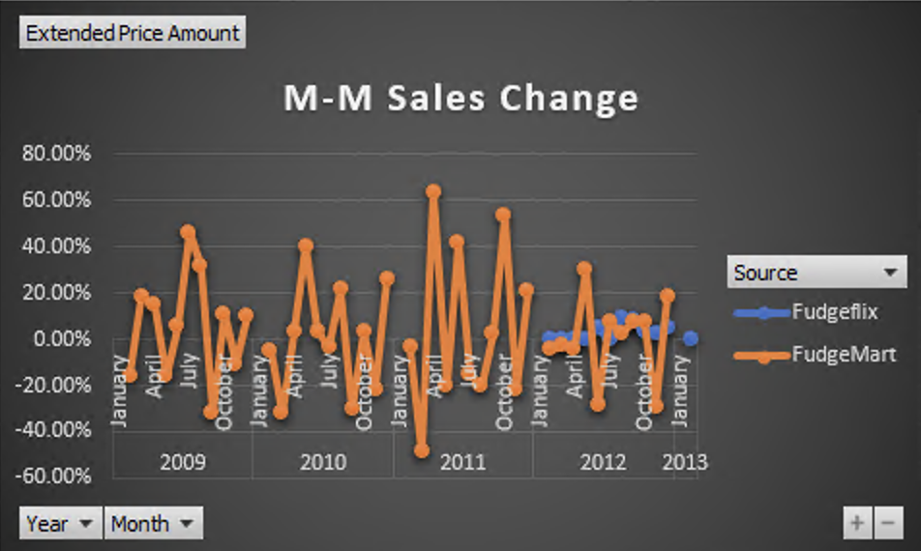
Combined analysis for FudgeMart & FudgeFlix

Slide 15
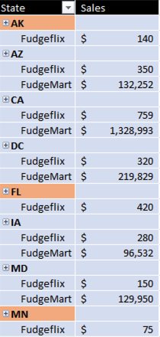
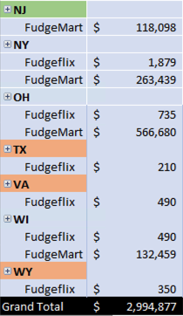
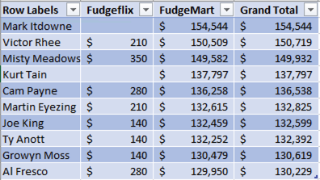
More cross-selling opportunities
48% of FM customers are also FF subscribers.
34% of FF subscribers are FM customers.
Top Spending Customers

Slide 16
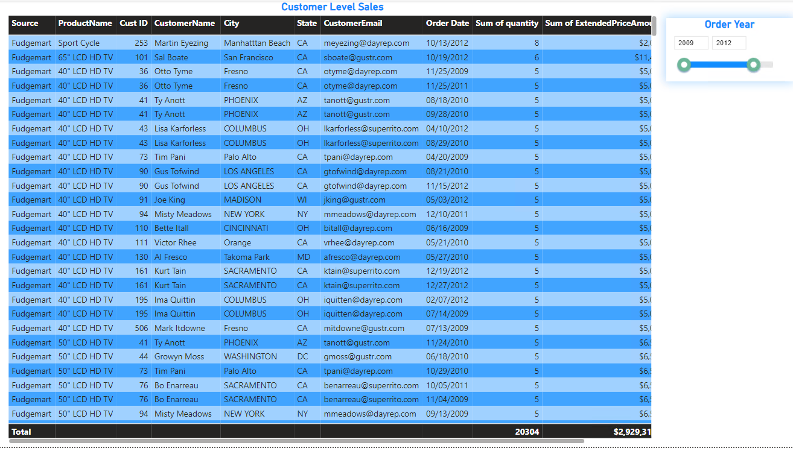

Slide 17
Recommendations
Fudge Mart need to increase sales as the overall sales is slowing down.
Invest more on marketing to convert FF customers to FM, focusing on states such as Florida, Texas, Virginia and Wyoming.
For states with lower sales on FM, increase investment on promotional offers.
Negotiate wholesale prices and increase the profit margin.

Slide 18

Questions

